Slide 1






Zeal IT Consultants
Introductions 101

Slide 2

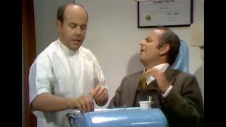
The Dentist

Slide 3
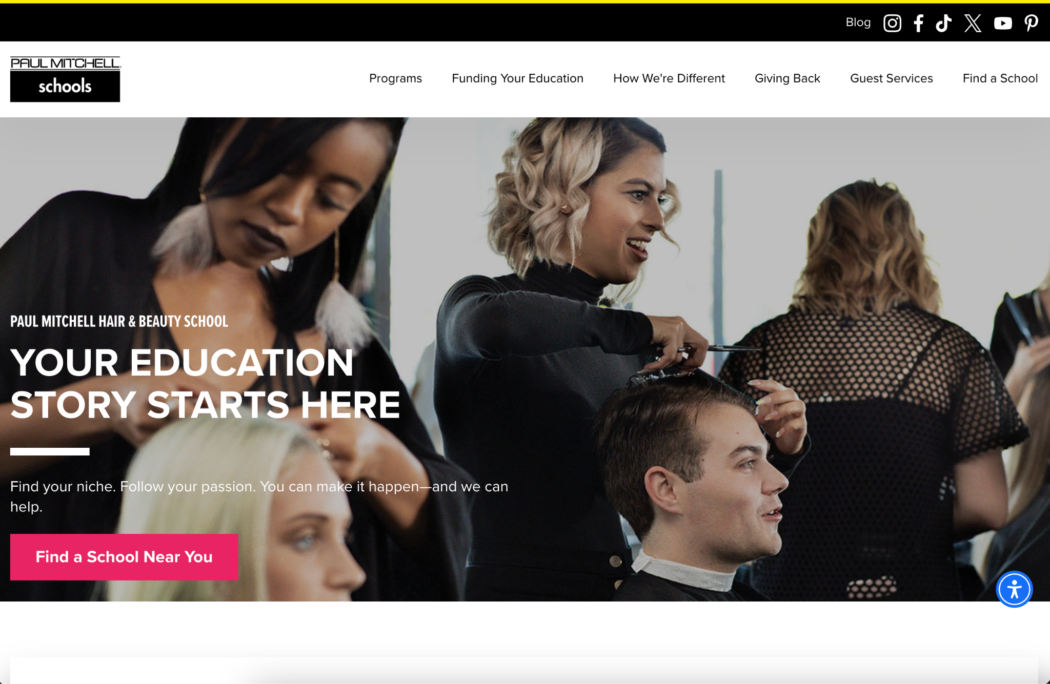
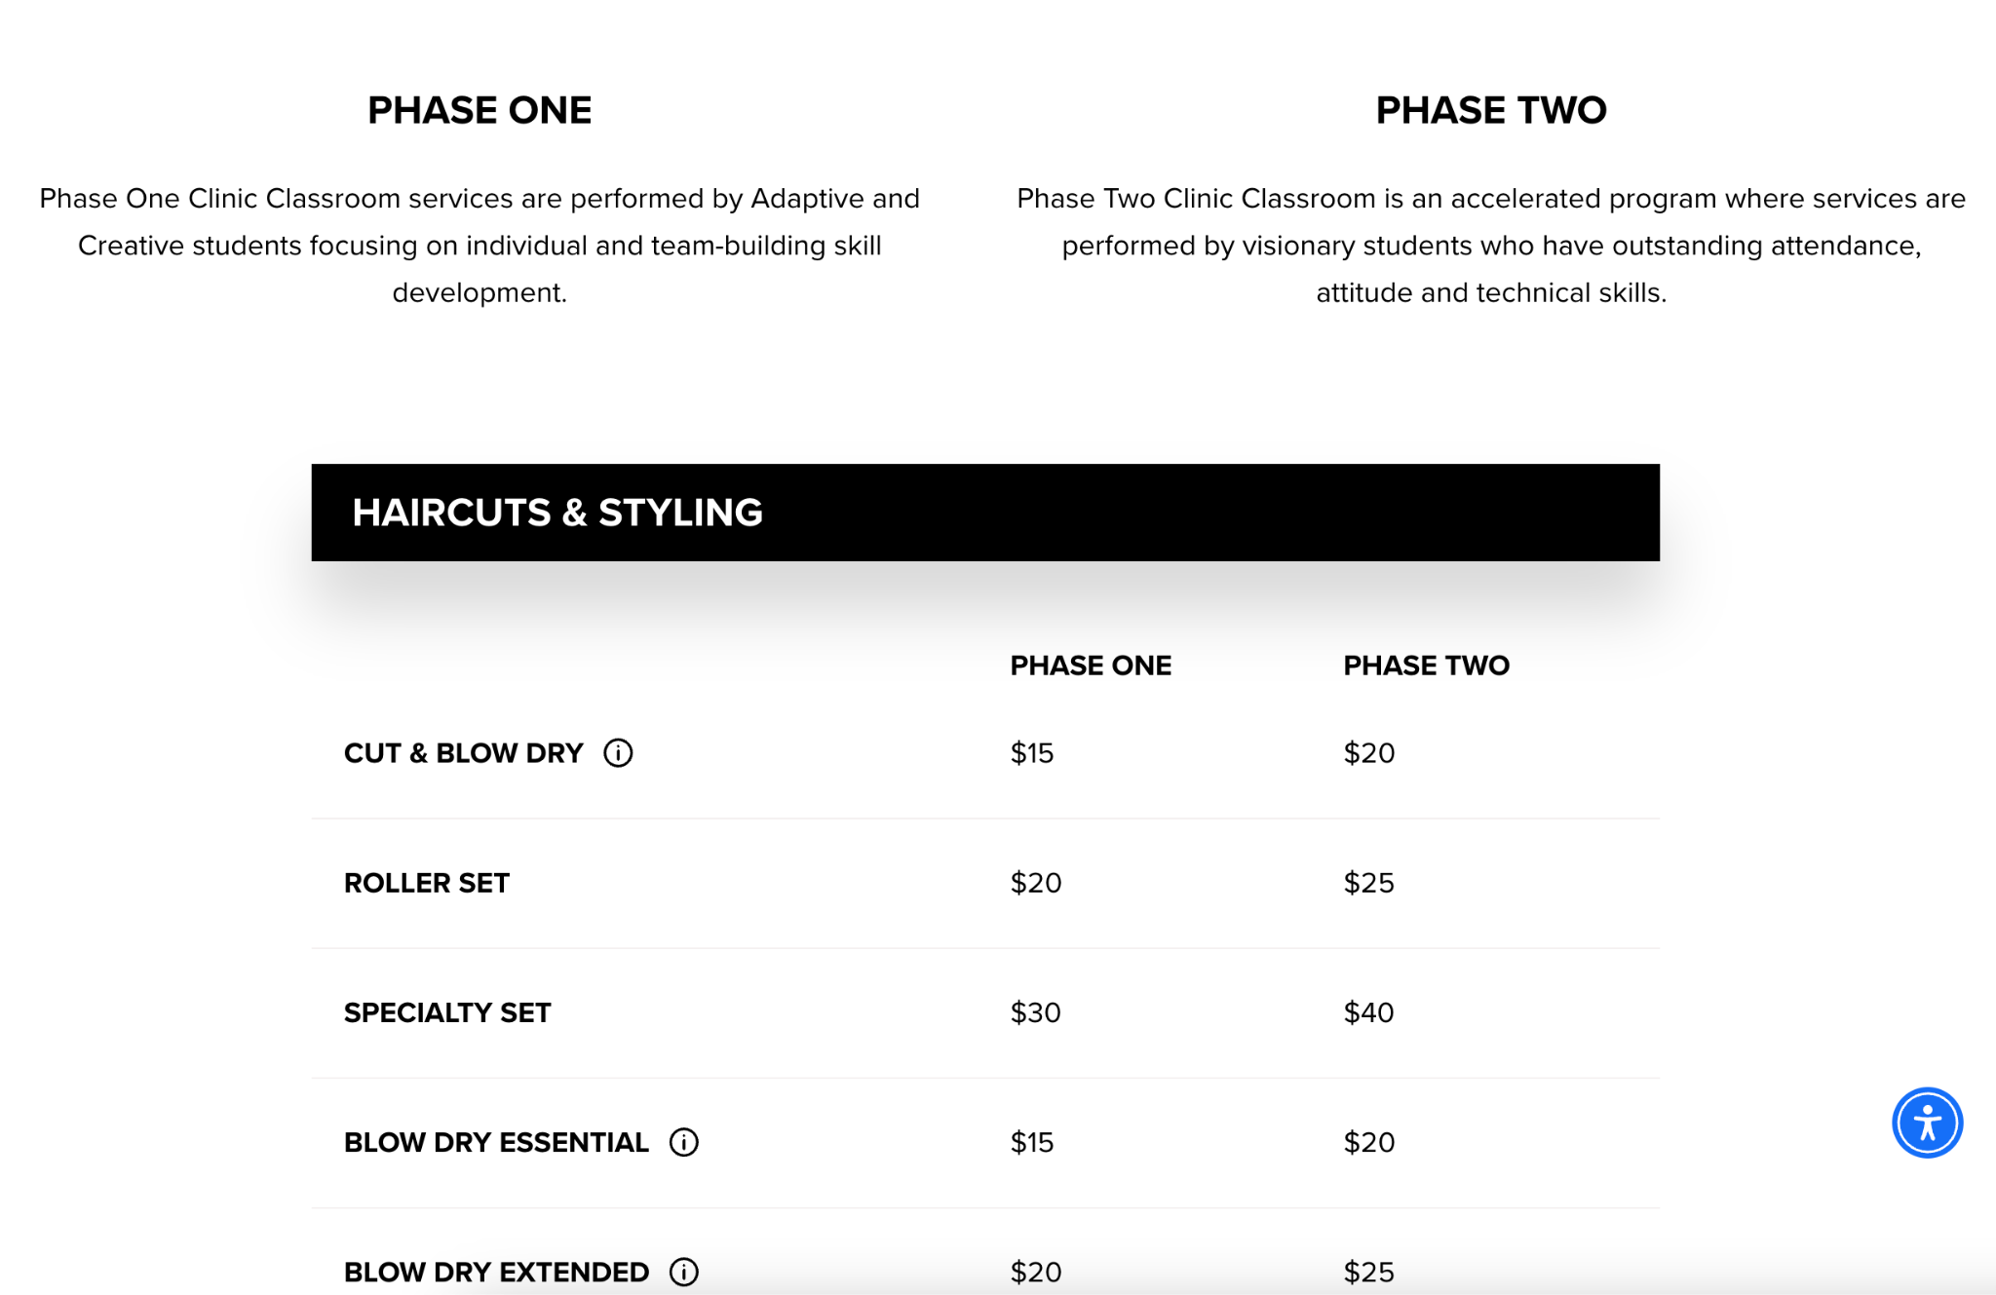
Paul Mitchell - The School

Slide 4
Awkward Client Experience

Slide 5
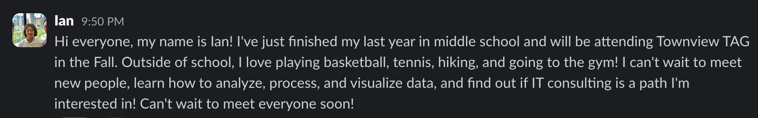
Communicating Confidence

Slide 6
Communicating Confidence
Hi everyone, my name is Ian! My primary focus right now is on being a student. Outside of school, I love playing basketball, tennis, hiking, and going to the gym! I can't wait to meet new people, learn how to analyze, process, and visualize data, and find out if IT consulting is a path I'm interested in! Can't wait to meet everyone soon!

Slide 7
Communicating Confidence
Hi everyone, my name is Ian! My primary focus right now is on being a student. Outside of school, I love playing basketball, tennis, hiking, and going to the gym! I can't wait to meet new people, learn how to analyze, process, and visualize data, and find out if IT consulting is a path I'm interested in! Can't wait to meet everyone soon!

Slide 8
Underselling yourself
What happens when you undersell yourself?

Slide 9
Underselling yourself
What happens when you undersell yourself?
You remove confidence from the client that you are able to effectively solve the problem they are bringing you in for.

Slide 10
Overselling yourself
What happens when you oversell yourself?

Slide 11
Overselling yourself
What happens when you oversell yourself?
Expectations become too high for you to manage and your window for grace when there is an issue becomes incredibly small.

Slide 12
Introduction Cheat Sheet
Your name
What value you are going to add to the project
You are excited to get started

Slide 13
Introduction Cheat Sheet
Your name
What value you are going to add to the project
You are excited to get started
Hello everyone, my name is Christian Gentry and I will be leading you through the internship program this summer. I can’t wait to meet each and every one of you and get started.

Slide 14
Zeal IT Consultants
Whatever you do,
do it with Zeal.

